Slide 1
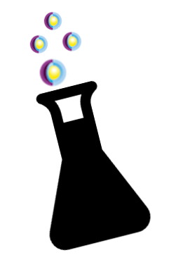
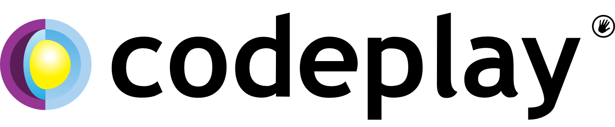
Experimentation Culture:
A collaborative approach to organisational improvement
by Serena Caruso
Notes:
name
A Codeplay Software story, a small startup born and raised in Edinburgh
Codeplay creates open-source libraries and development tools for accelerated computing. They started in 2002 building tools for game developers to create advanced graphics, they were the first company to really leverage GPS for anything else rather than graphic. They originally made compilers for PlayStations, and as they could support parallel processing their product was adopted on supercomputers. And then in 2011 they start focusing on defining and adopting open standard for GPU compilers, standards that all the major technology companies will end up adopting.
From small startup, to tasty investment for a big player...so much to adapt to, so many different challenges and problem to solve, so much to improve,,,,,but how does improvement work at organizational level?

Slide 2
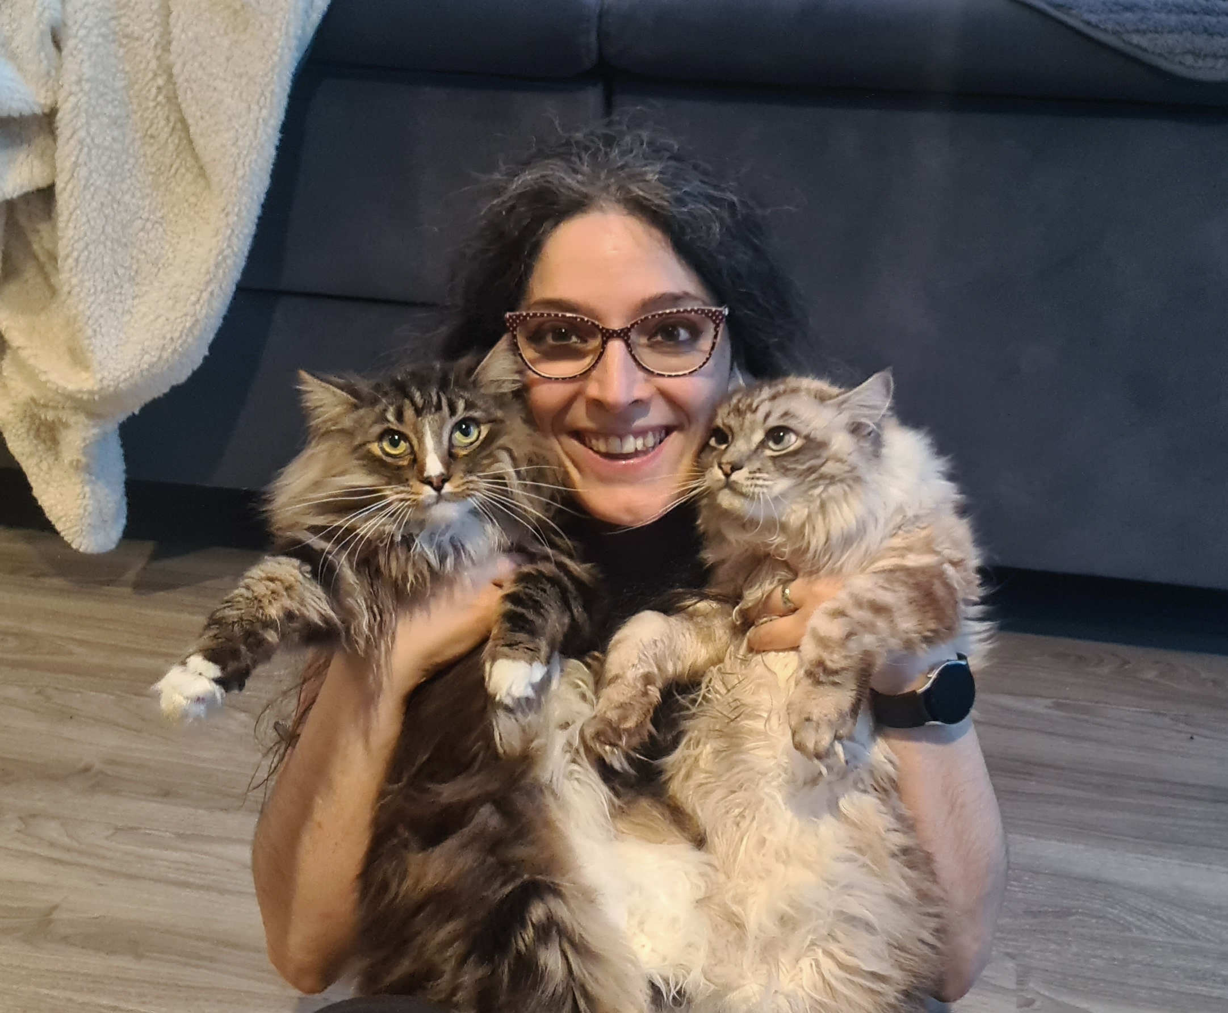
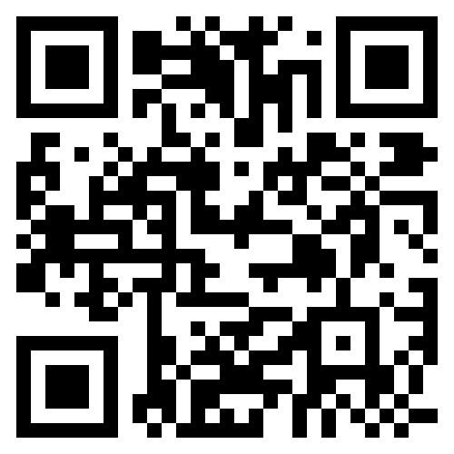




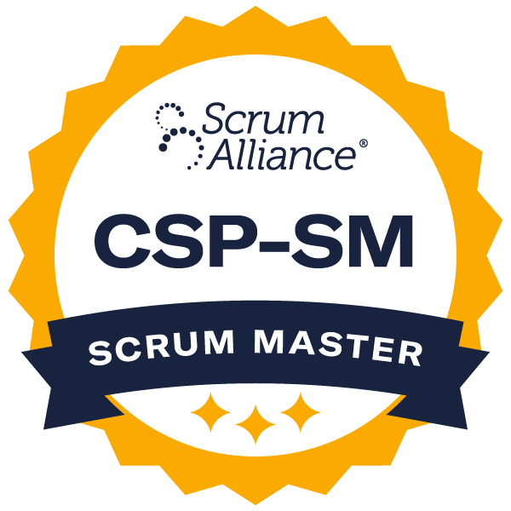
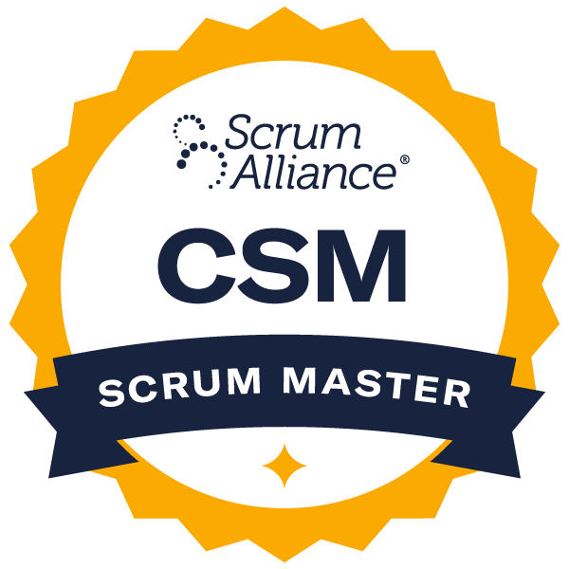


Cats Mum
Agile Coach
Incidentally, Jira Expert
Hire me
Notes:
Speaker card
Not currently in Codeplay

Slide 3




I’m changing this, I know best!
scope
impact
problem
I wish someone did something to help…
Everything is great
What if… shame I can’t
ownership
result
Notes:
About organizational improvement and change, in a bigger company.
Well it would typically go like this:
- Bob would have an idea that would make our life easier, but not the time and authority to making it happen
- Heather is the enabler in charge, but doesn't know there is a problem that needs to be solved
- Meanwhile Lisa is receiving lots of feedback stating the need for a change, but she is mindful a change would impact Bob's division, or step in Heather's toes, so doesn't do anything
- Somewhere else Mike is actually handling the same matter following his own judgement, and when casually Bob shares his idea with him, he says so.....no, I'm already taking care of that. Leave this to me.
6 months later
- Heather has still no clues what happened
- Bob is unhappy with the impact of Mike's initiative
- Mike claims success, his idea went live, his idea therefore worked
Lisa is now looking for more feedback and data on change decisions and success criteria, wondering if that can be beneficial to her division, but can't find info
In more practical terms we are lacking visibility on problems, scope and impact, ownership, weren't clear any more and comm was bad enough
So let's take a step back, how would we even know there is a problem to solve….

Slide 4
management 1:1s
Team Retrospectives
Internal Audit
Release / Project Retrospectives
Teams Health Checks
Feedback is
Key
coaching 1:1s
People Support feedback
Company Council
HR Employee Survey
Direct CEO Feedback Channel
Project Management Improvements log
Notes:
There are many way to understand the problems, observation, data, but our main tool would have been Feedback.
we would pride ourself to be a company people led, and a company that listens.
Over the years put in place numerous mechanisms to get feedback and understand the problems:
- team retrospectives
- team health check
- HR employee feedback form
- internal audit
- project managers improvement log
- people support feedback
- direct CEO feedback channel
- Council
Encouraging feedback has been always a core effort in my company, but following up, has proven always a challenge, and we know that for motivating employees not following up on feedback is worse than no asking feedback at all.

Slide 5
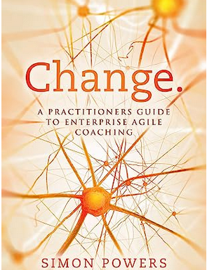
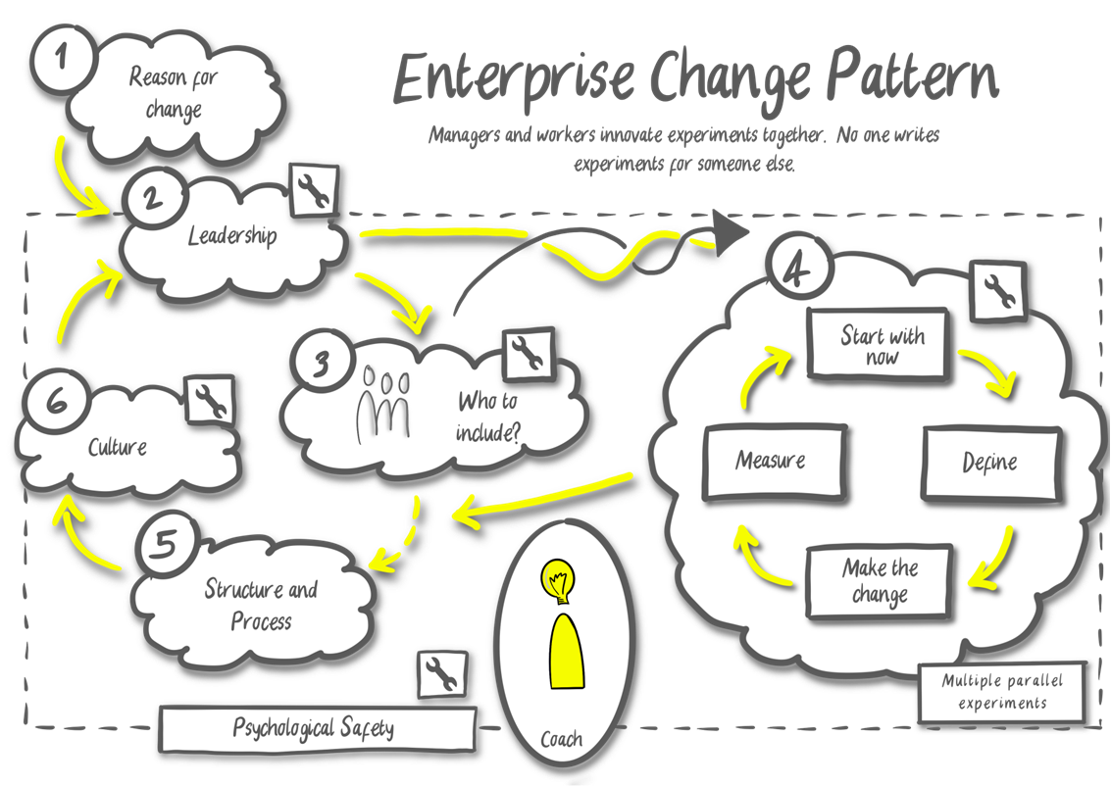
Enterprise Change Pattern
Notes:
So , it's in this context that I started to explore how to apply something I had recently learned to our situation.
2 years ago I’ve attended the internship from Simon Power for the ICAgile ICE-EC. And learn about the Enterprise Change Pattern.
The framework approaches changes as experiments, encouraging iteration loops, transparency and employees’ participation and accountability in decision making and constant assessment of the experiment success.
It all starts with:
a reason for change, whether it is a problem to solve or an opportunity to catch;
Leadership support in enabling the framework by giving authority to cross-division teams (called “Alliances”) to design and apply experiments;
Building an Alliance for that specific topic, a focus group with
people directly impacted by any potential experiments on the topic
decision maker roles required
influencer and power dynamic roles
and a facilitator.
Size of the Alliance is constrained by the facilitation limitations and logistics.
Multiple Alliances can be created, but they would have different people in order to empower more and parallelize the effort. Each Alliance will consider the status quo, design an initial experiment to move towards a desired place, measure, review, iterate, and so on. Working very similarly to an Agile team, but with a rhythm and a schedule as much as possible compatible with our full time job.
The structure and process of the org will change as effect of these experiments, as Leadership is granting safety to dare!
As that happen, culture has a chance to change. Culture is not something that can be changed directly; you can change structure and process that have a knock off effect on culture.
The change in culture will allow Leadership to grow and change their style of leadership towards a more empowering one, and the loop becomes more likely to continue

Slide 6
Pitching the
Codeplay
Experiments Lab
CEL
Notes:
The next 4 slides, were my pitch to Codeplay to put in place something I would call Codeplay Experiments Lab, meaning to become our own framework for experimentation inspired by the Enterprise Change Pattern

Slide 7

Challenge I: a systemic approach
We have several company wide feedback channels, but not a systemic approach to spot patterns and common roots
We struggle to put together the right stakeholders for each matter
There is no discourse about different options and visibility on their efficacy
Notes:
We talk about feedback a lot recognizing how important it is, and we work a lot to gather it; but we don't have a systemic approach to process this company wide feedback, across the various media; a way to spot patterns, discuss options with all the “sides of the dice” on the table
processing the multitude of feedback channels in a systemic way, need of understanding which ones can be tackled in isolation and which ones have a common root and require a team work

Slide 8

Challenge II: from changes to experiments
We don’t shy away from changes, but we are not used to approach them as experiments, meaning we are not:
Setting success criteria
Setting evaluation periods
Have measurements in place
Evaluate alternative options
Regularly review the learnings and iterating on the previous experiments
“Applying a change” does not constitute an achievement in a complex system. Learning is the achievement; the culture of trying –learning-retrying- is the actual achievement of a complex organization
Notes:
Shift from change to experiment. Nothing new for this crowd I know and a concept we are familiar at team level, perhaps treating retro actions as lean experiments, but totally new for us at company level.
That's because most of the time, the moment we apply a change we assume the work is done.
We don't shy away from changes, we have shown willingness to do things differently many times, but we don’t have the culture to call the change “experiment”, and keeping following up on the action, measuring, reviewing, appreciating the learning.
A complex environment such ours doesn't have a "right way to do something", we are a dynamic entity, what works and what not shifts continuously, therefore we can't stop at "making changes" and call it an achievement. We need to pursue outcomes (over output) and understand what works and how what works changes in time. This means developing a mindset of experimenting, keeping measuring the outcome, learning from that, and tweaking the experiments again as soon as circumstances change, and rinse and repeat.
The learning, the understanding that things have changed and therefore the organization needs to change again, is the real achievement, not the change itself.

Slide 9
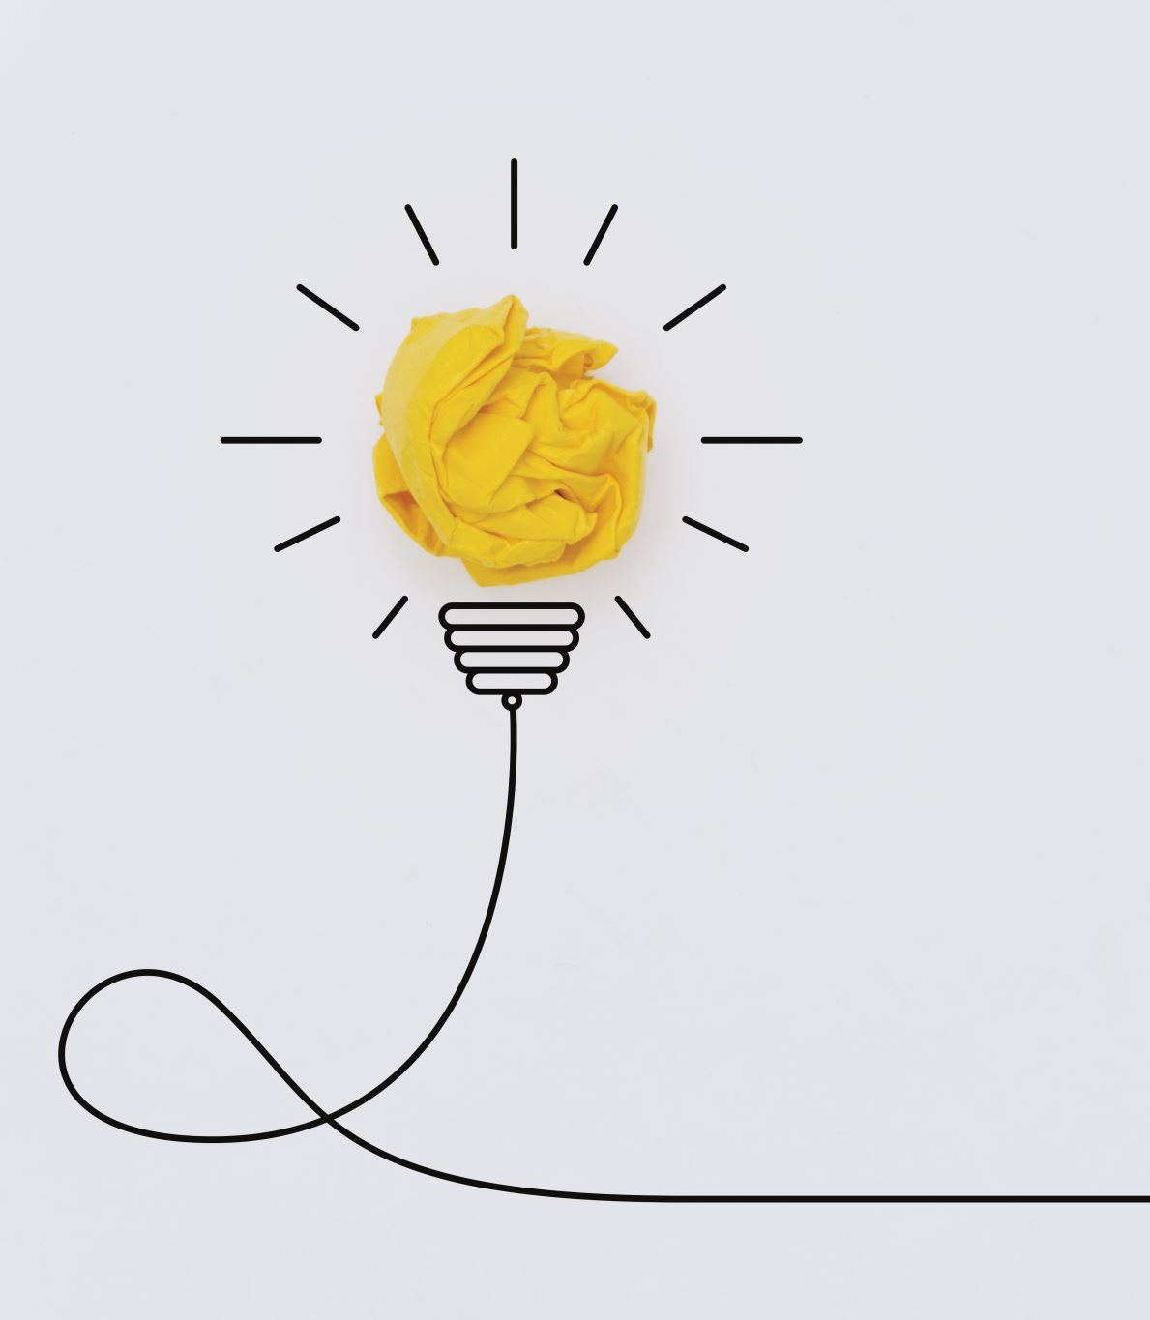
Challenge III: from individual ownership to collective learning
When an individual owns a change proposal it’s hard to evaluate it without bias and be ready to let it go. Ownership of the proposal kicks in and overrides the highest good.
A shift from personal idea to group experiment, encourages collective learning and embracing of “failure” as fundamental mechanic of the growth process.
Notes:
Shift from individual ownership to collective learning. Individual ideas are hard to let go, to evaluate objectively and not to be proud of. Collective ownership make easier to understand that it's not about winning or loosing experiment, but about learning....any outcome leads to learning, collective learning remove the bias and ego from the table
Great things have happened and keep happening, and sometimes not so great things happen, bad moves which are hard to admit.
That happens when changes are put forward through champions, proposing great ideas, or disappointing ones, creating heroes and villains, and making difficult and awkward evaluating objectively your change: Our ideas are a bit of us, and it's hard to let them go and admit personal failure.
Although part of this mindset is getting comfortable with failure – as failure is just a bad word for learning - having an entity that approaches the problem at hand systematically, without individual ownership, does help to avoid attachment and pride to an experiment, embracing the inevitable moment of failure as just the moment where the previous experiment no longer works and needs to evolve. That's how we unlock a growth mindset.

Slide 10
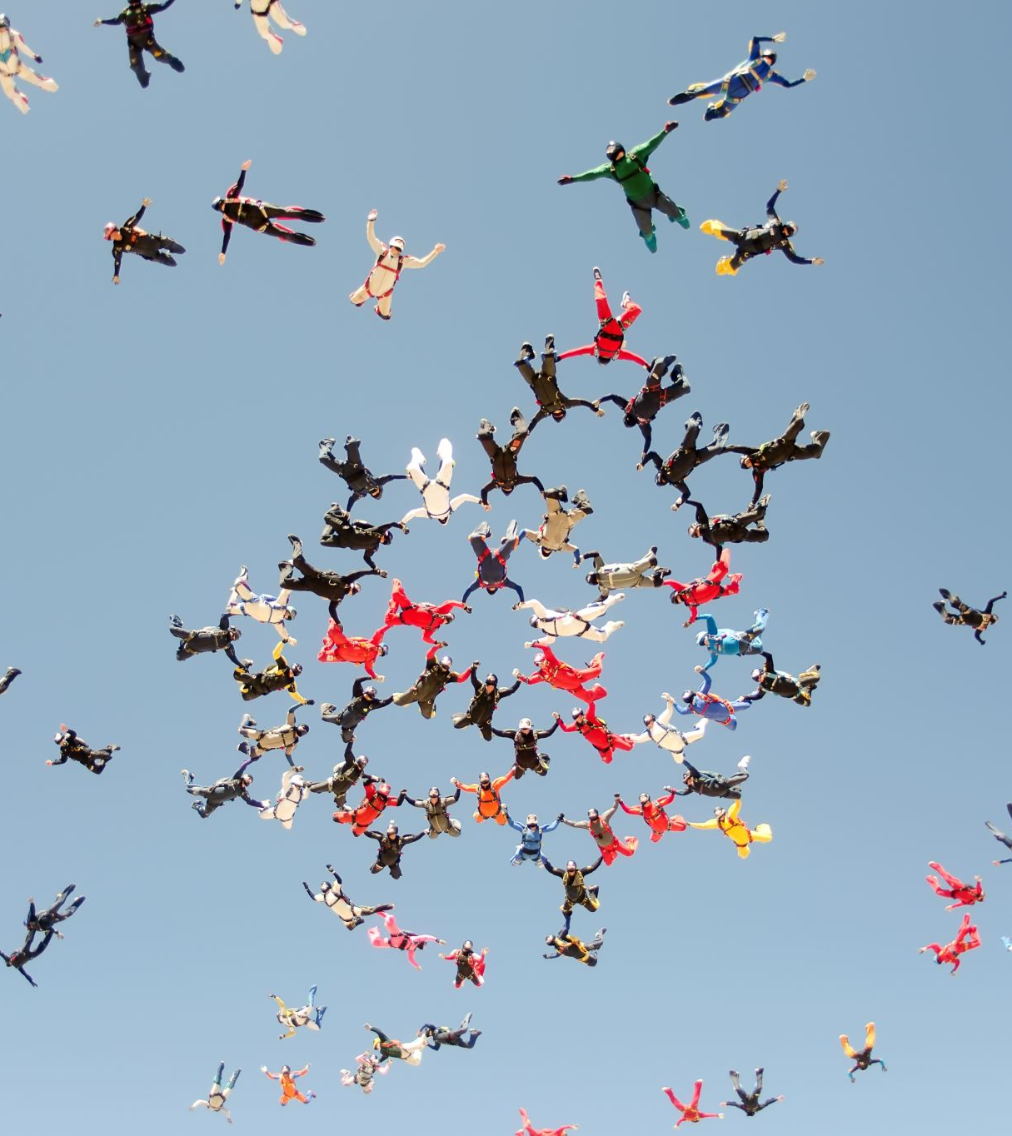
Challenge IV: dare to try!
Who is empowered to carry on an initiative?
Changes or experiments spanning across multiple teams and divisions, easily meet political deadlock, sometimes with no real reason for it, but just because the weight of such a decision is intimidating and taking action is politically scary.
A person or group carrying on an experiment needs to have a clear empowerment and mandate.
Notes:
And finally, mandate to action!
Avoid that stall between Bob and Lisa, allow the afore mentioned group to take action, meaning making sure that everyone understand the group will be empowered to overlook the experiment
Finally, changes that span across areas of influence, are simply too hard to initiate.
Sometimes it's a political barrier, sometimes it’s simpler than that, it's just a deadlock scenario, where decisions are heavy so no one want to make a first step or suggest something that someone else may not like.
Pleasing people is also another huge source of deadlock, but pleasing everyone is impossible and suboptimal. So what could we do?
We can agree to put our trust in a group representing at best various perspectives of the Codeplay community and . We can let them unleash their courage, empowering them - employees with their trust and Leadership with their mandate - to design an experiment that will be tried no matter what (as long as sustainable), unlocking new learning and again reinforcing a mindset of growth and bottom up empowerment.

Slide 11
What is our most urgent issue?
Feedback Taskforce
Notes:
My way to apply the ECP has been a little meta…
<description>

Slide 12
Activities
Feedback Taskforce: sense making workshop
Alliance kick-off
Experiment design workshop
Experiment launch
Notes:
Feedback Taskforce: what to focus on
Forming an Alliance (a multidisciplinary task force team, across different levels of seniority, assembled to tackle the prioritised need)
- Designing Experiments
- Launching an Experiment
Finally and most importantly:
- Lessons learned up to this point
- Future challenges

Slide 13
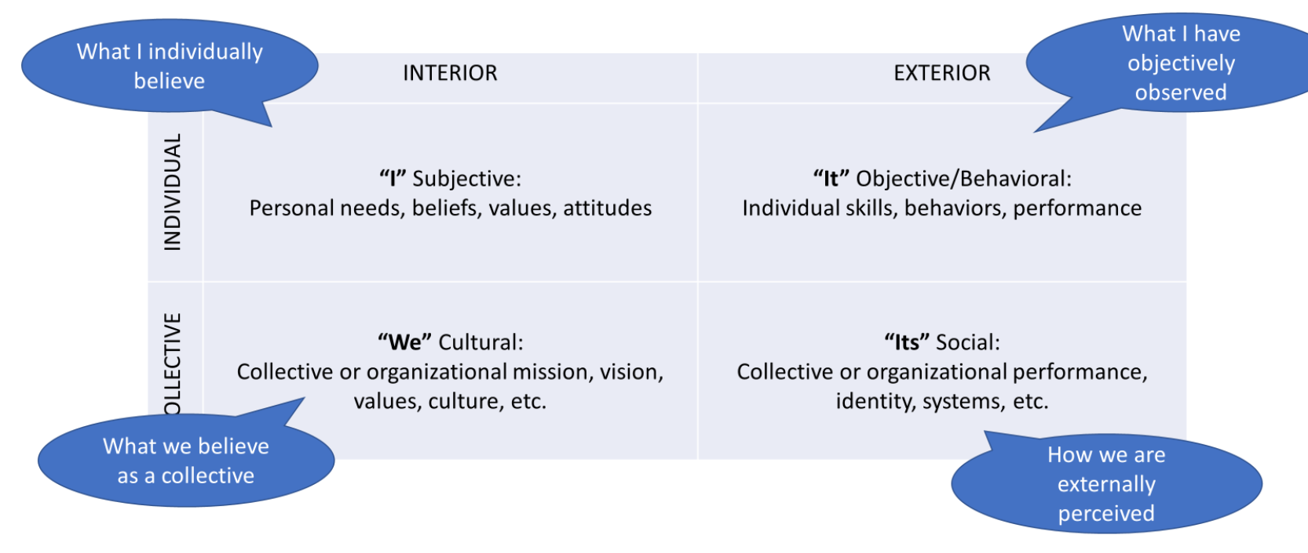
Feedback Taskforce: sense making workshop
Integral Model Exercise

Slide 14
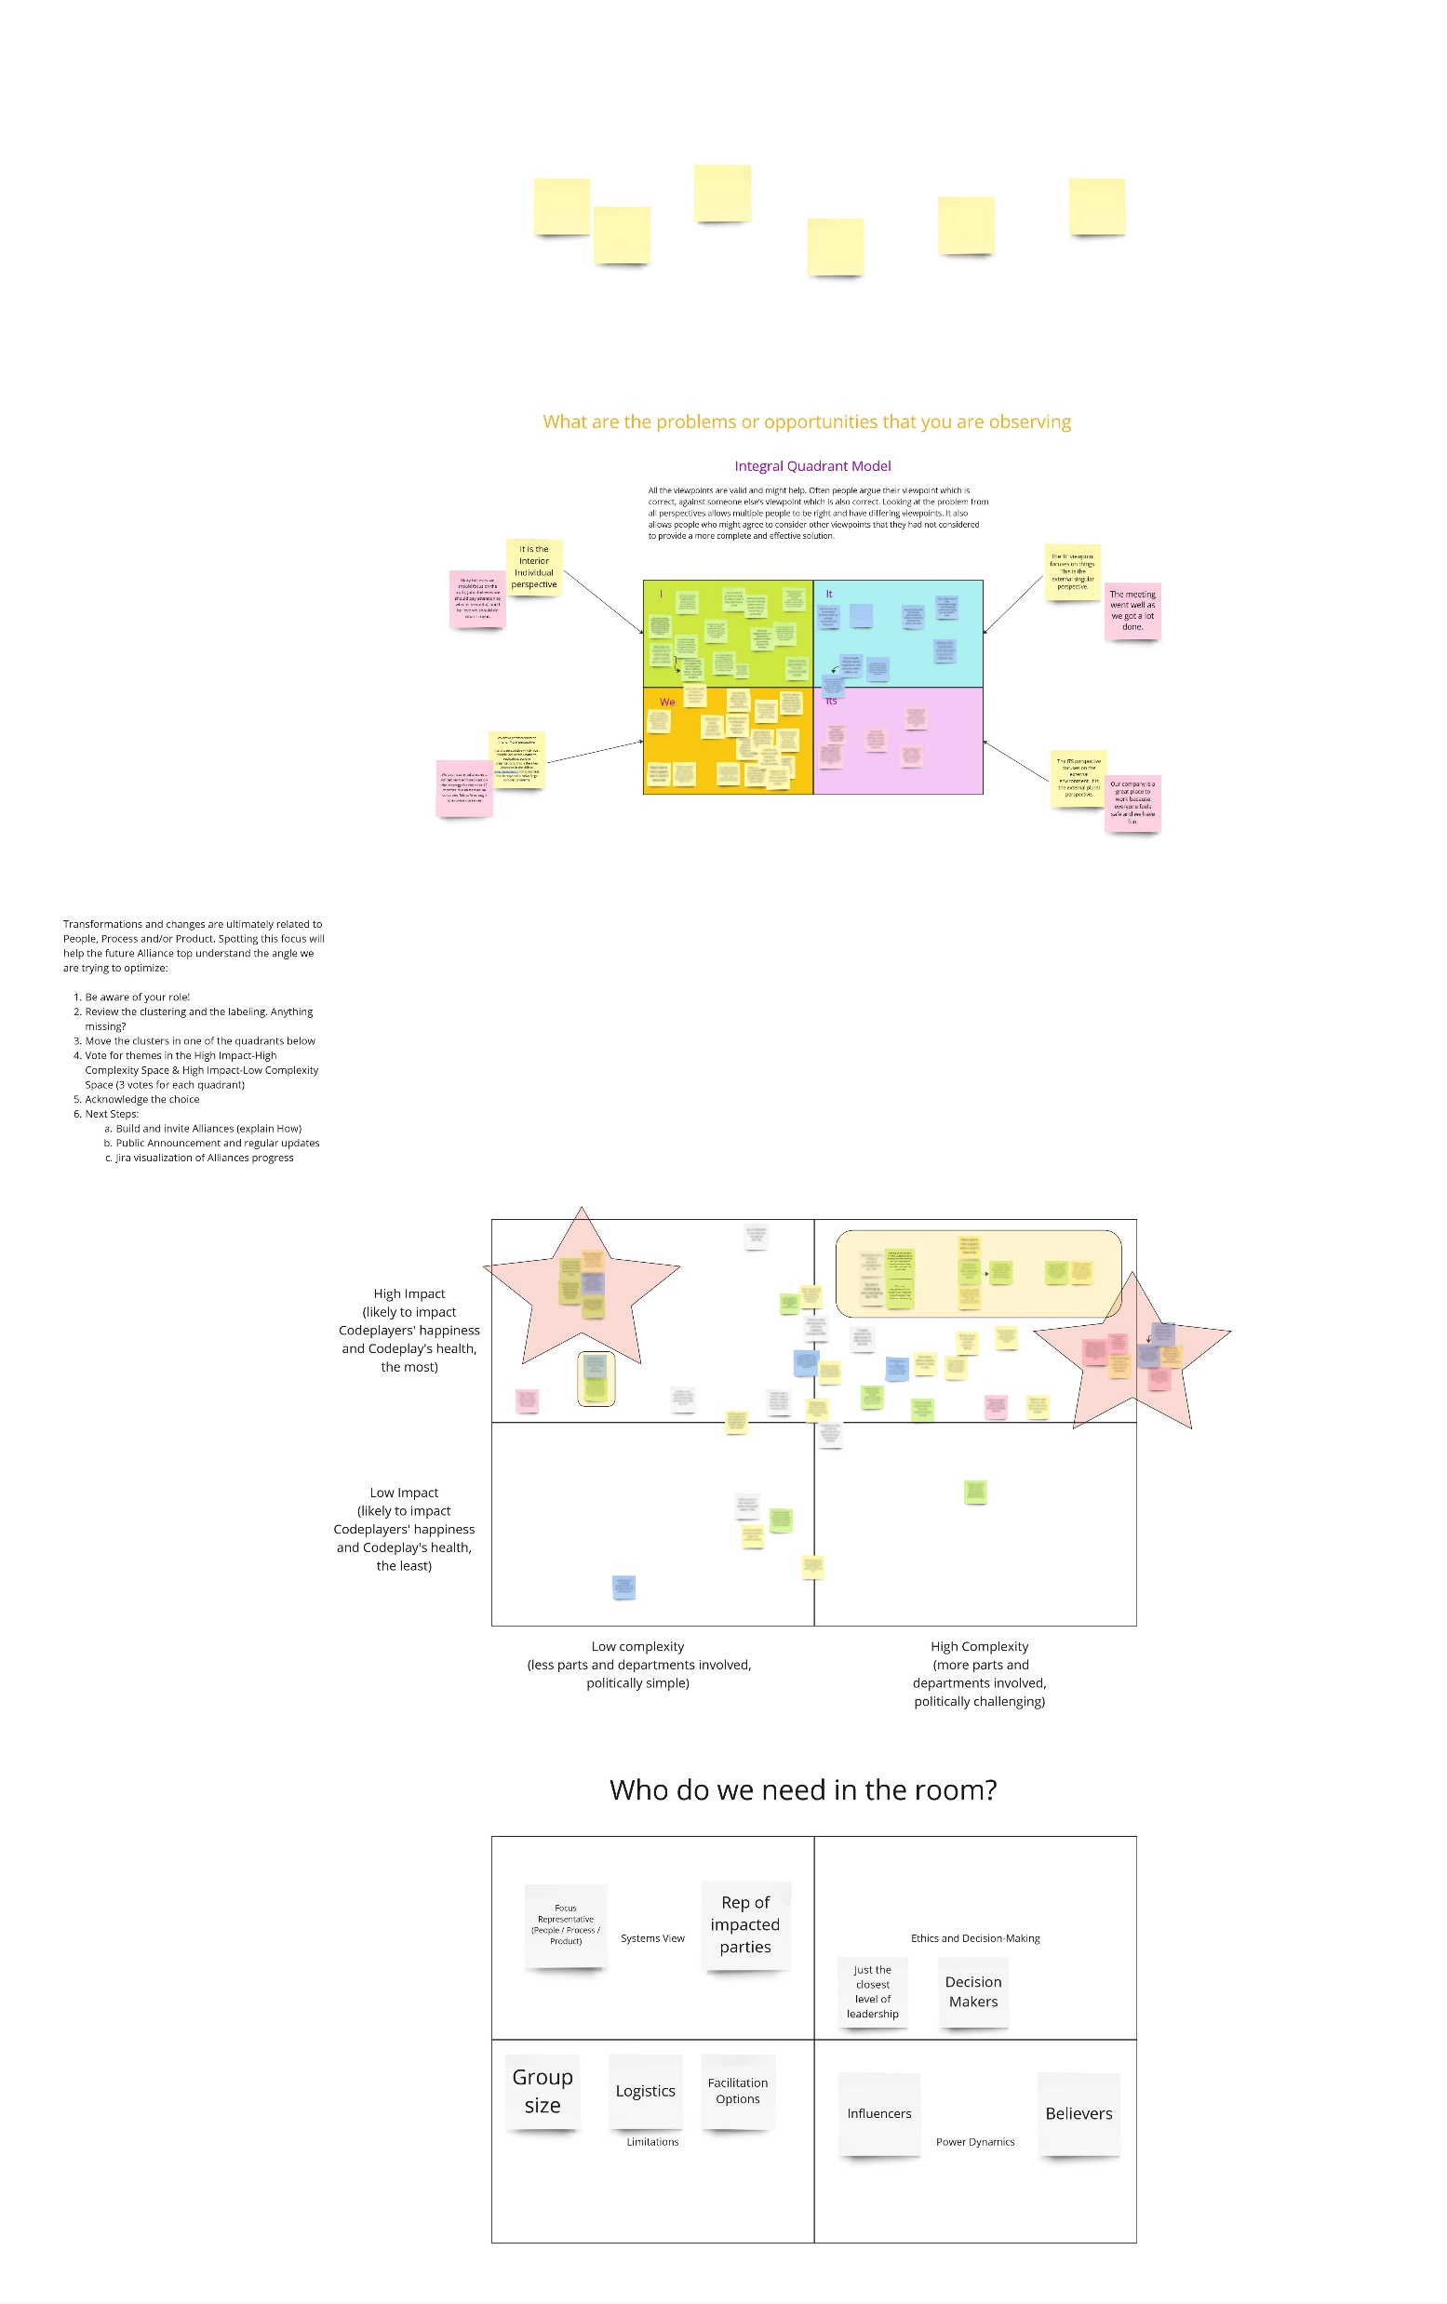
Feedback Taskforce: sense making workshop
Filtering & Prioritization
Notes:
Explain the exercise on the left, and the filtering on the right

Slide 15
Alliance Kickoff
Public Announcement of the Initiative and area of focus
Public Jira Ticket representing the area of focus and call for Alliance members
Prerequisites

Slide 16
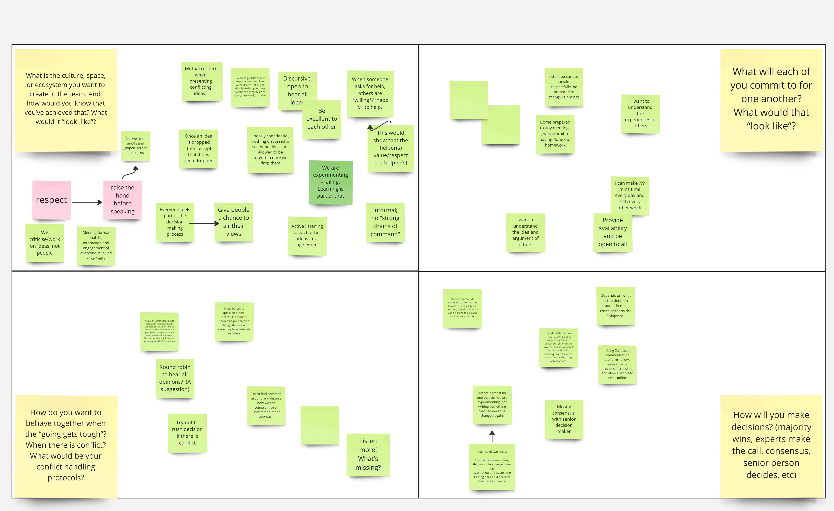
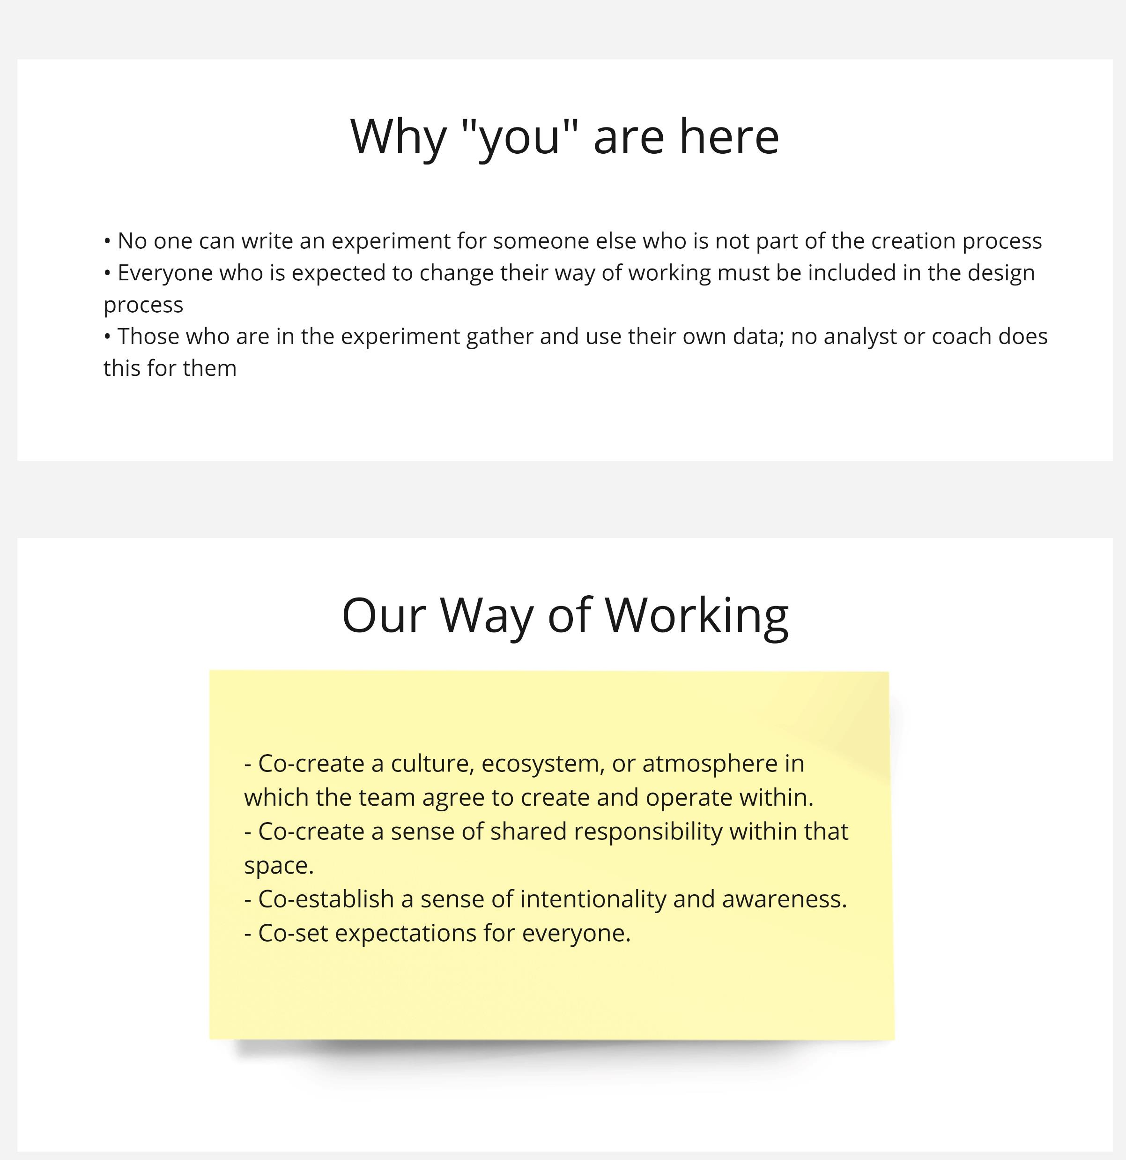
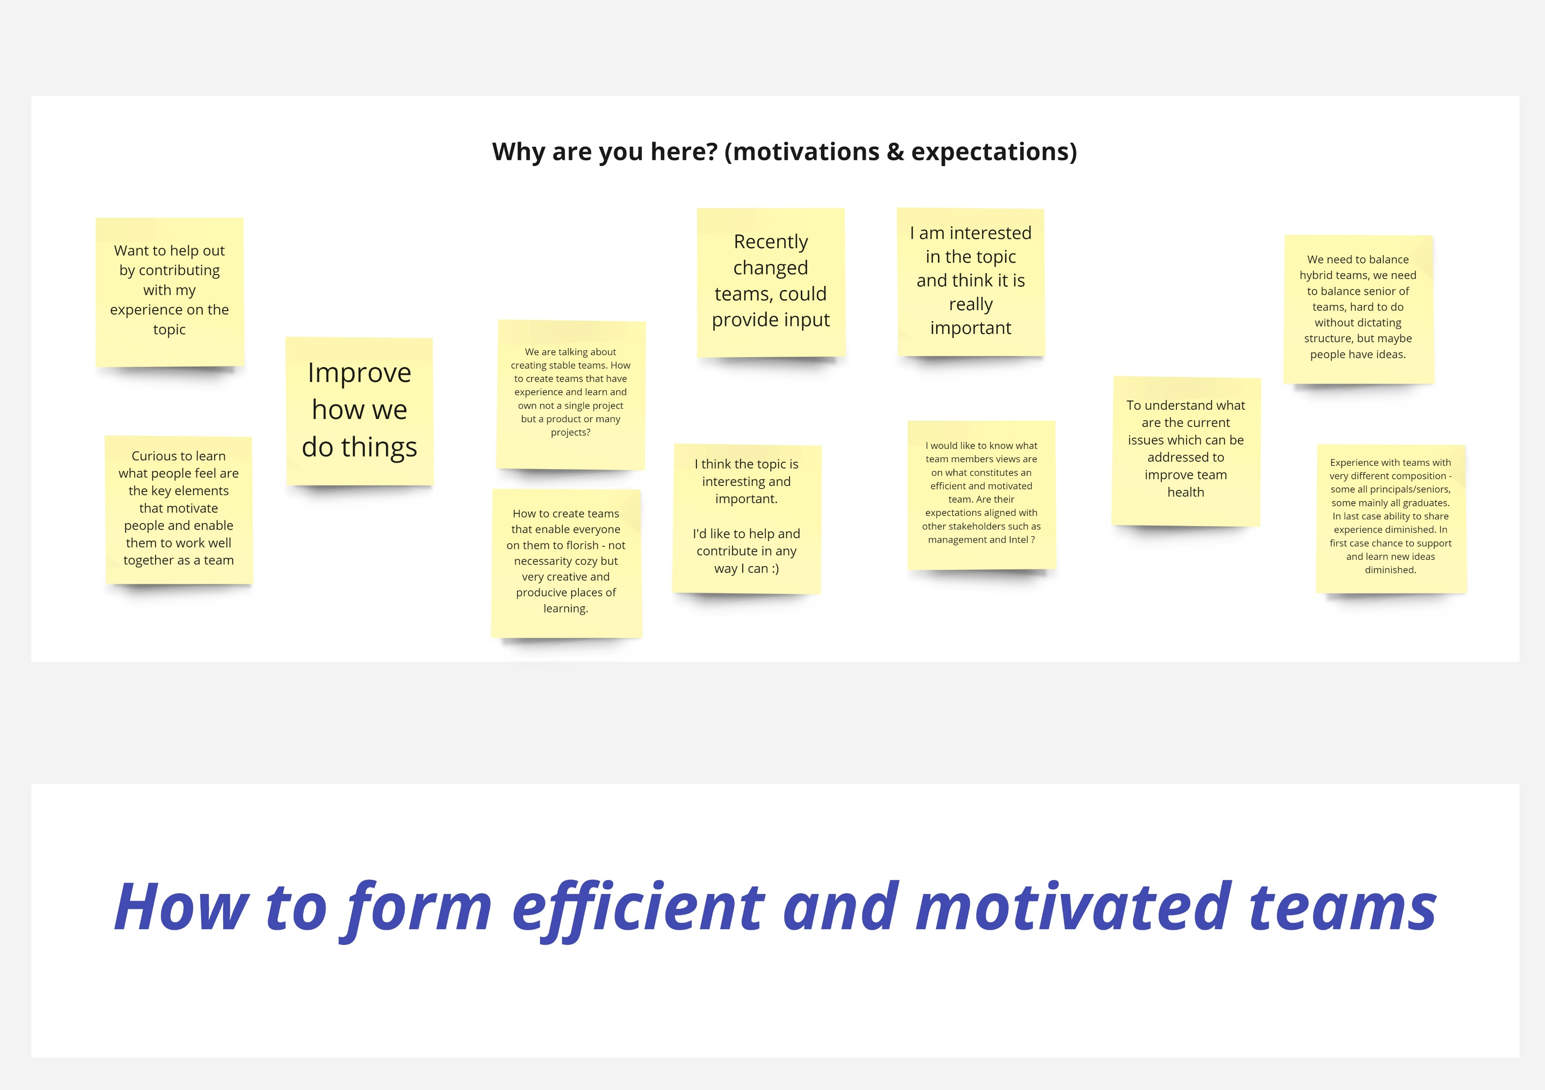
Alliance Kickoff
Expectations and Psychological Safety
Notes:
Talk through those boxes. Then explain the Kickoff
Who do we need in the Alliance
Motivation & Expectations
Remind the purpose and why You are here
Agree a way of working
Create Safety
What is the culture, space, or ecosystem you want to create in the team. And, how would you know that you’ve achieved that? What would it “look like”?
What will each of you commit to for one another? What would that “look like”?
How do you want to behave together when the “going gets tough”? When there is conflict? What would be your conflict handling protocols?
How will you make decisions? (majority wins, experts make the call, consensus, senior person decides, etc)

Slide 17


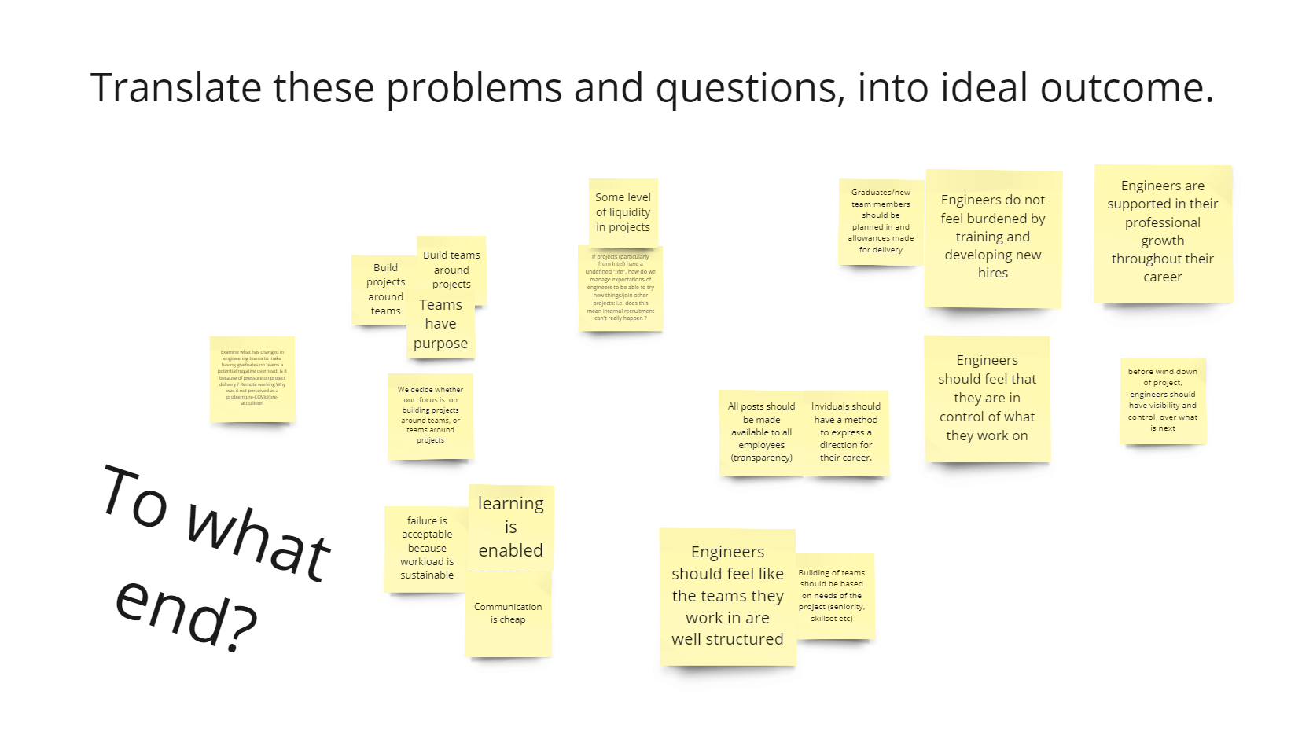
Experiment Design Workshop
Identifying the Problem
Translate the feedback into ideal outcome
The following feedback concerning this topic has been raised:
Misalignment of hiring strategy regarding graduates: our ability to hire raw talent has always been a focal point of our strategy, but this doesn’t align with teams’ capacity to cope with grads and bring them up to speed
Some teams seem not keen to invest time and resources on graduates
How to build effective teams (experience and seniority ratio, skillset, etc)
Some Product Engineering teams are built around projects, not around team-building principles (size, experience, ability to take on diverse projects, stable)
Many feel like having no more ability to choose in advance what their goal/project will be
How do we keep the flexibility for engineers to apply for the internal project of their choice ?

Slide 18
Experiment Design Workshop
Collaborative Ideation
Working in pair nominate the "spark" of the duo.
The spark picks an outcome and suggest an action towards that; the other person builds on that with "Yes And"; continue building on each other for a few times.
Then swap spark.
Keep going until the end of the timebox.
Learning is enabled
Engineers can change teams
Teams understand their purpose
Engineers do not feel burdened by training and developing new hires
One step towards that…
One step towards that…
One step towards that…
One step towards that…
Yes And…
Yes And…
Yes And…
Yes And…
Notes:
This may just be throw away work, but it’s a training towards collective generation and ownership

Slide 19
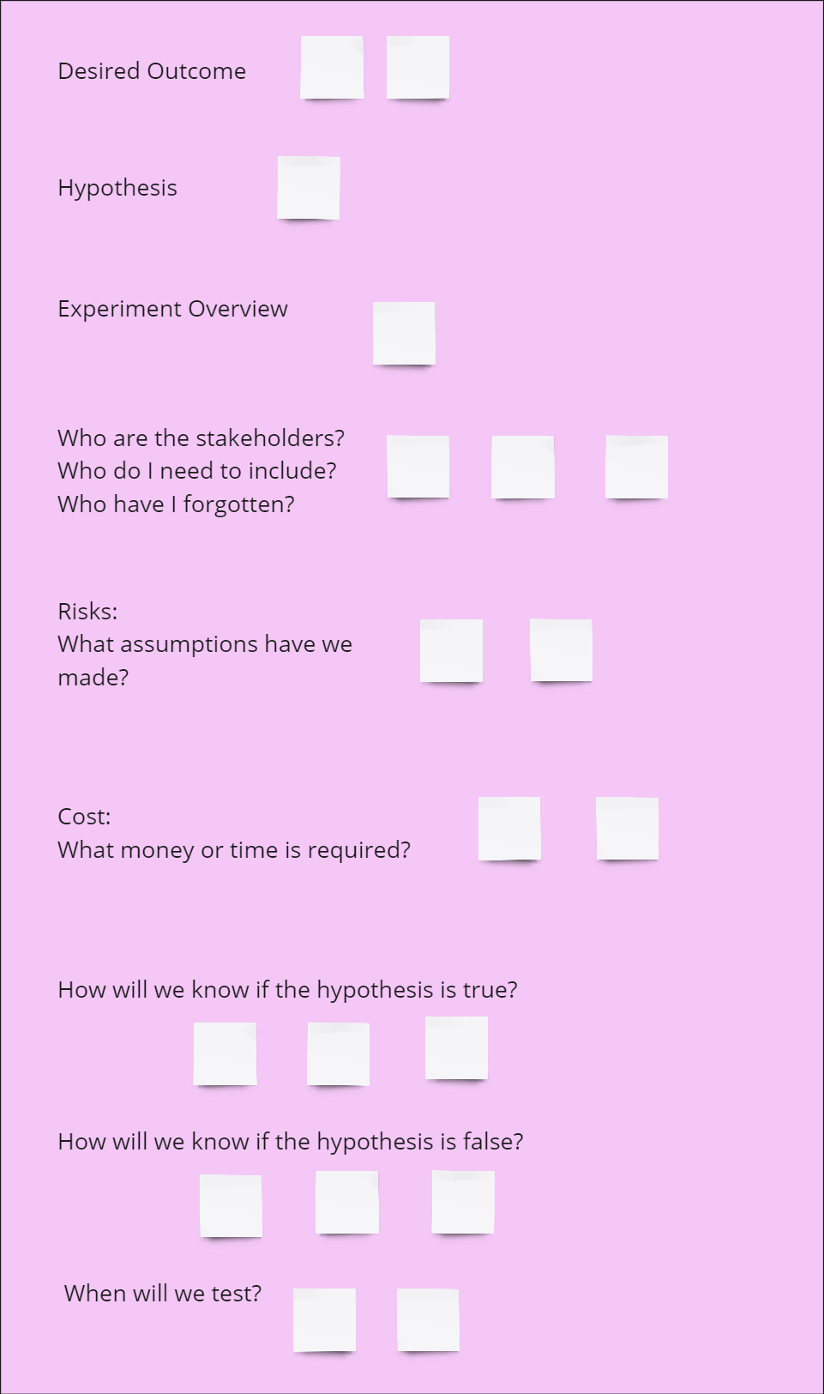
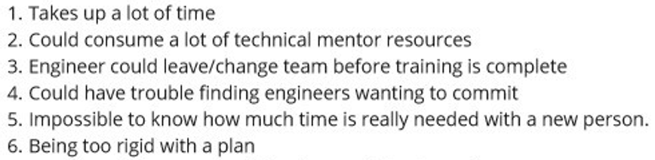


Experiment Design Workshop
Designing Practice
Training and developing new hire without that to become a burden for engineers
Individually: Focusing on one or 2 outcome and inspired by the previous exercise, create a small and safe step towards the outcome (use the experiment template as a thinking tool)
As a pair: Pitch the experiments to each other, help formalizing them, review them and tweak them for consensus.
As a group: Review the experiments, discuss the conditions for success and failure and tweak them for consensus.
If there is an explicit plan for mentoring, it’s less likely to impact team performance and taking too much of the senior engineers’ time

Slide 20
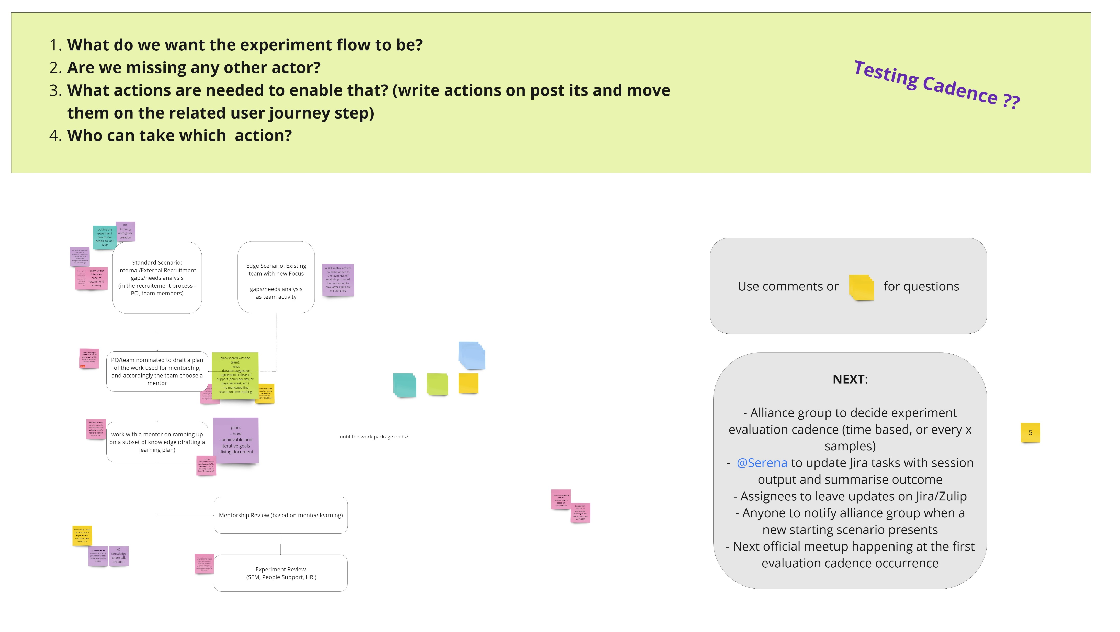
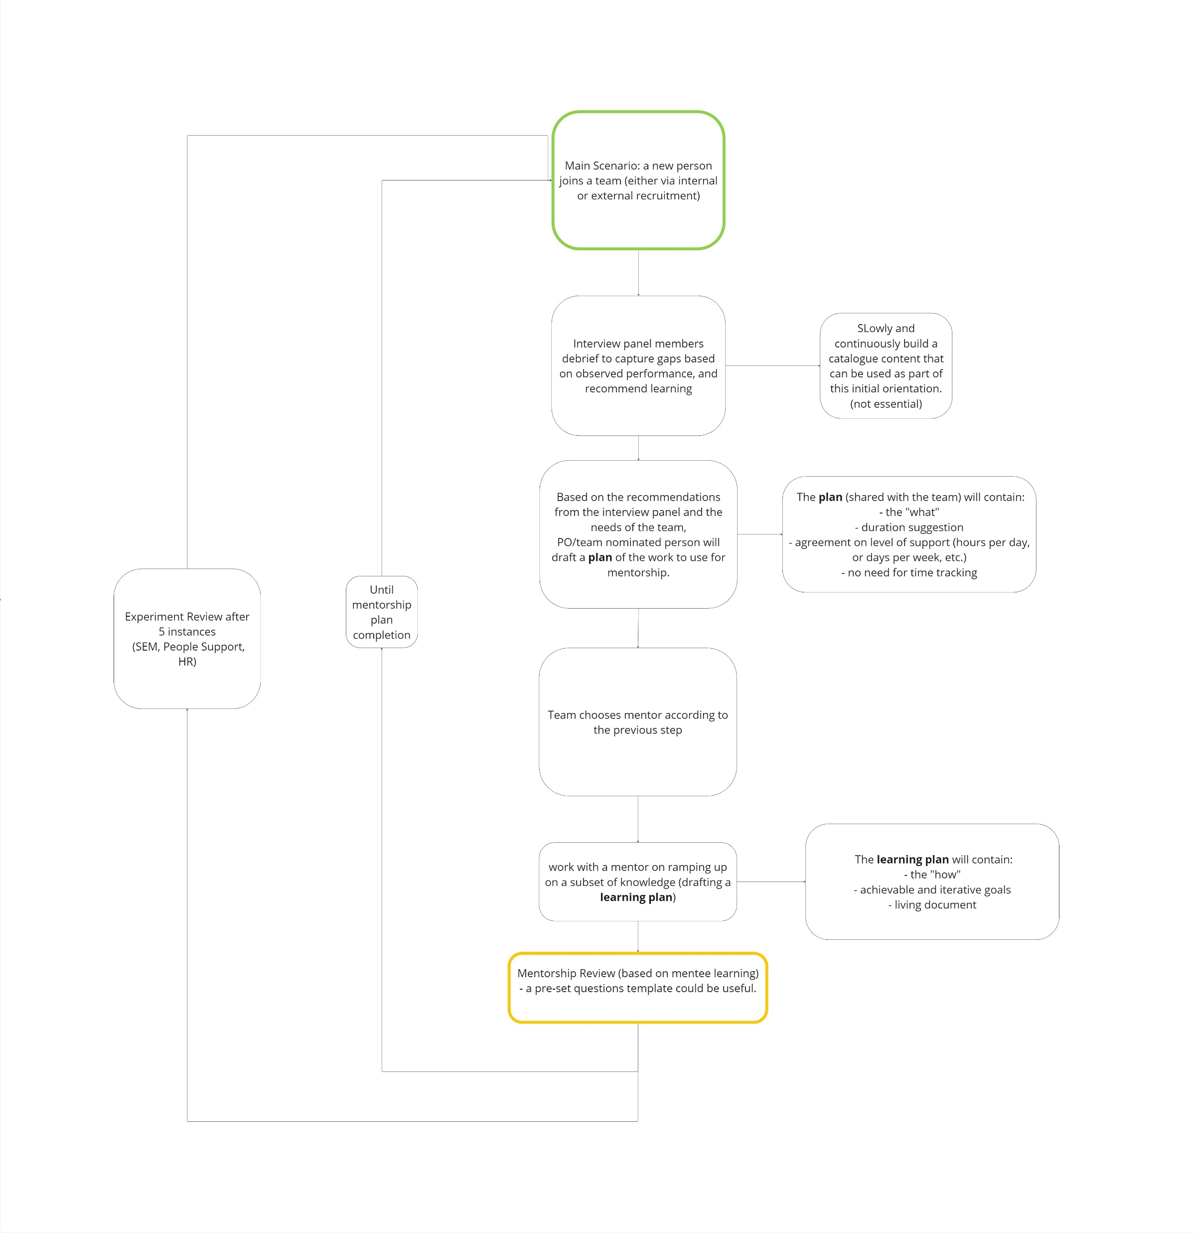
Experiment Launch
Planning
It will trigger any time someone joins a team
Every 5 occurrences we’ll meet and reevaluate

Slide 21
Experiment Launch
Follow Up Channels
Intense use of Zulip channel for offline synchronization
Jira project mapping the Problem as Epic and the chosen Experiment as a nested ticket
HR leading the implementation as main enabler given the domain
Company wide announcement of the experiment via Zulip, company hall and agile talk

Slide 22
Lessons learned: about the CEL
How to improve as a system?
Reason for Change
Leadership
Feedback Taskforce
Culture
Who to include?
Structure and Process

Slide 23
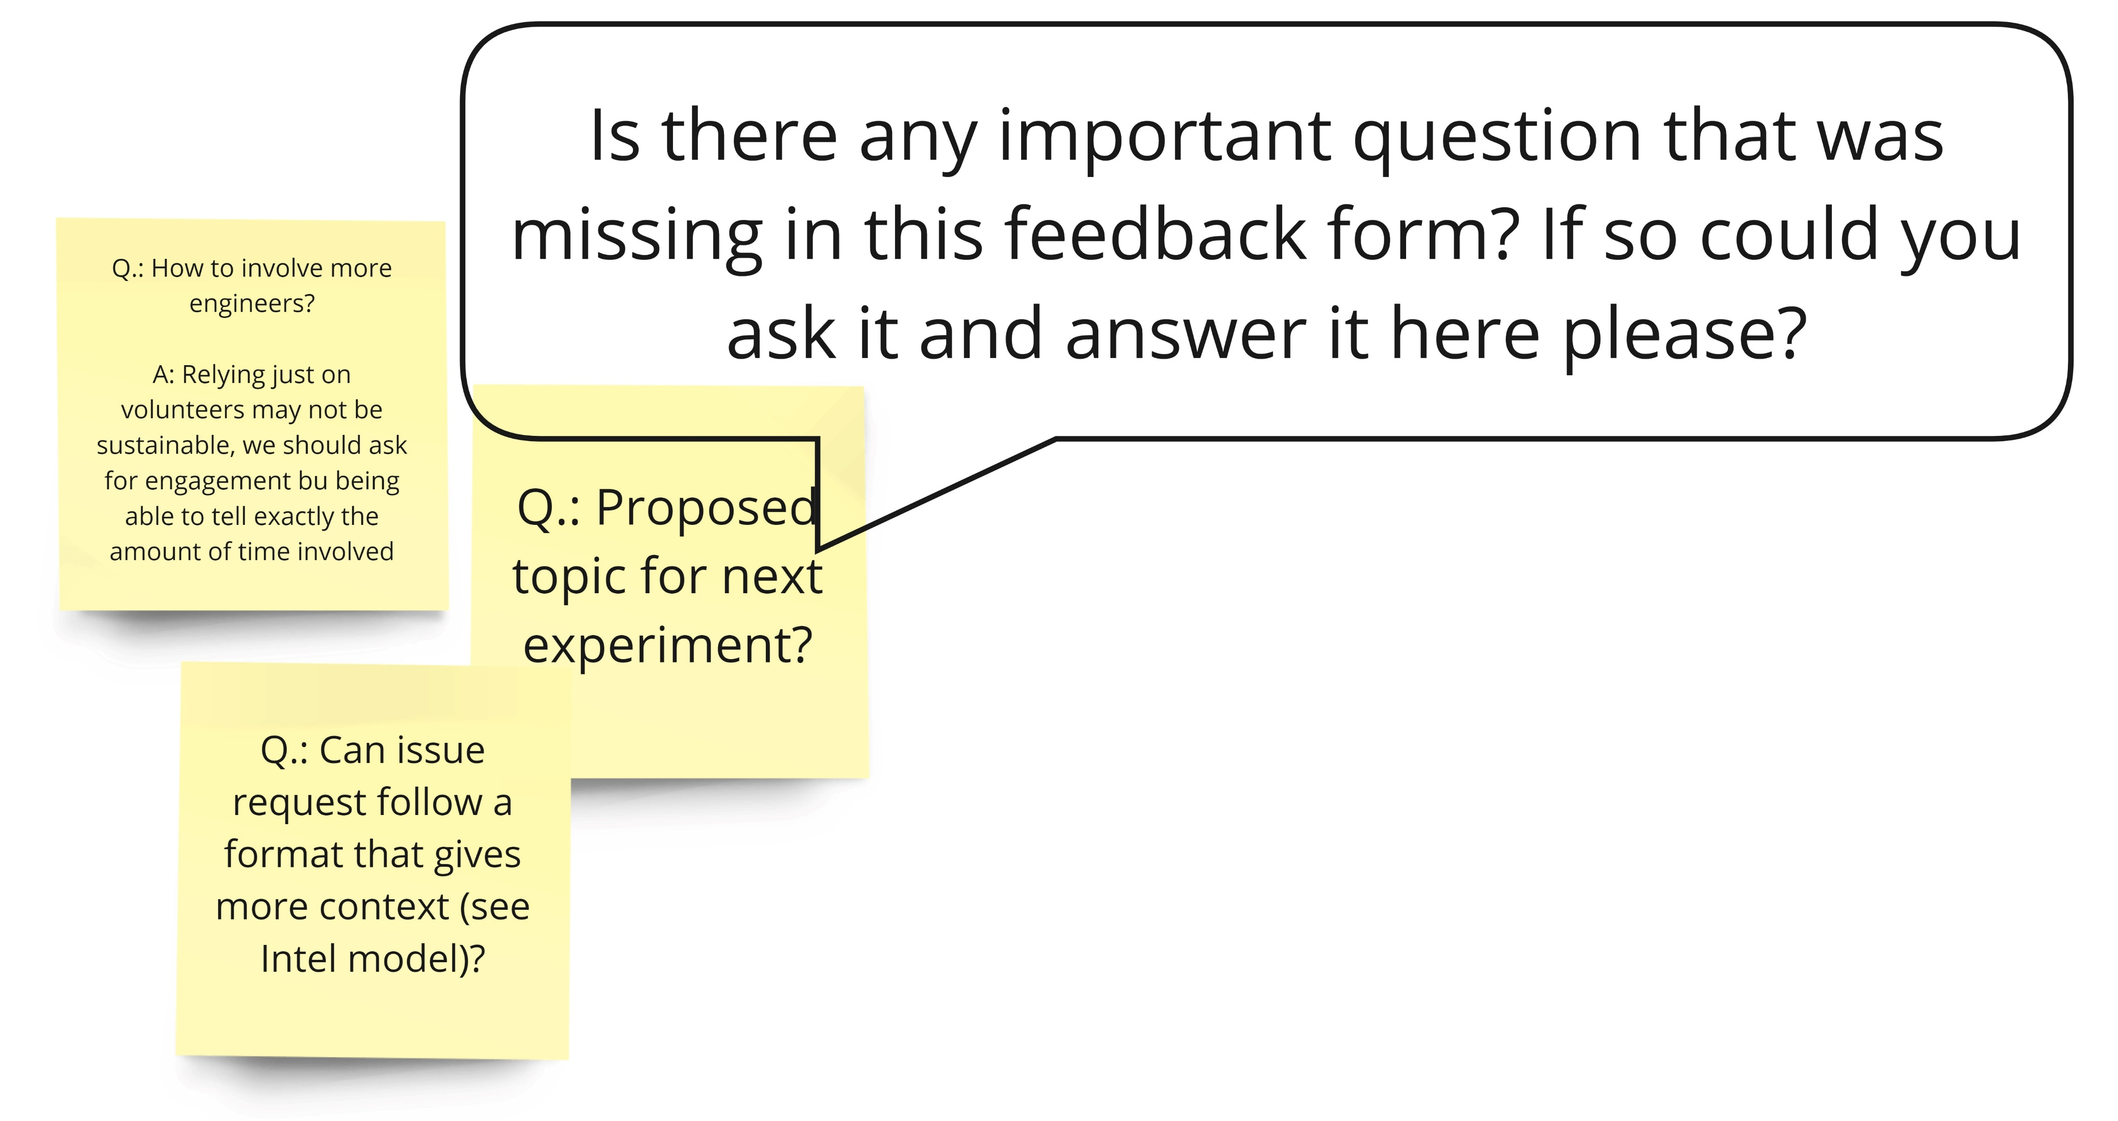
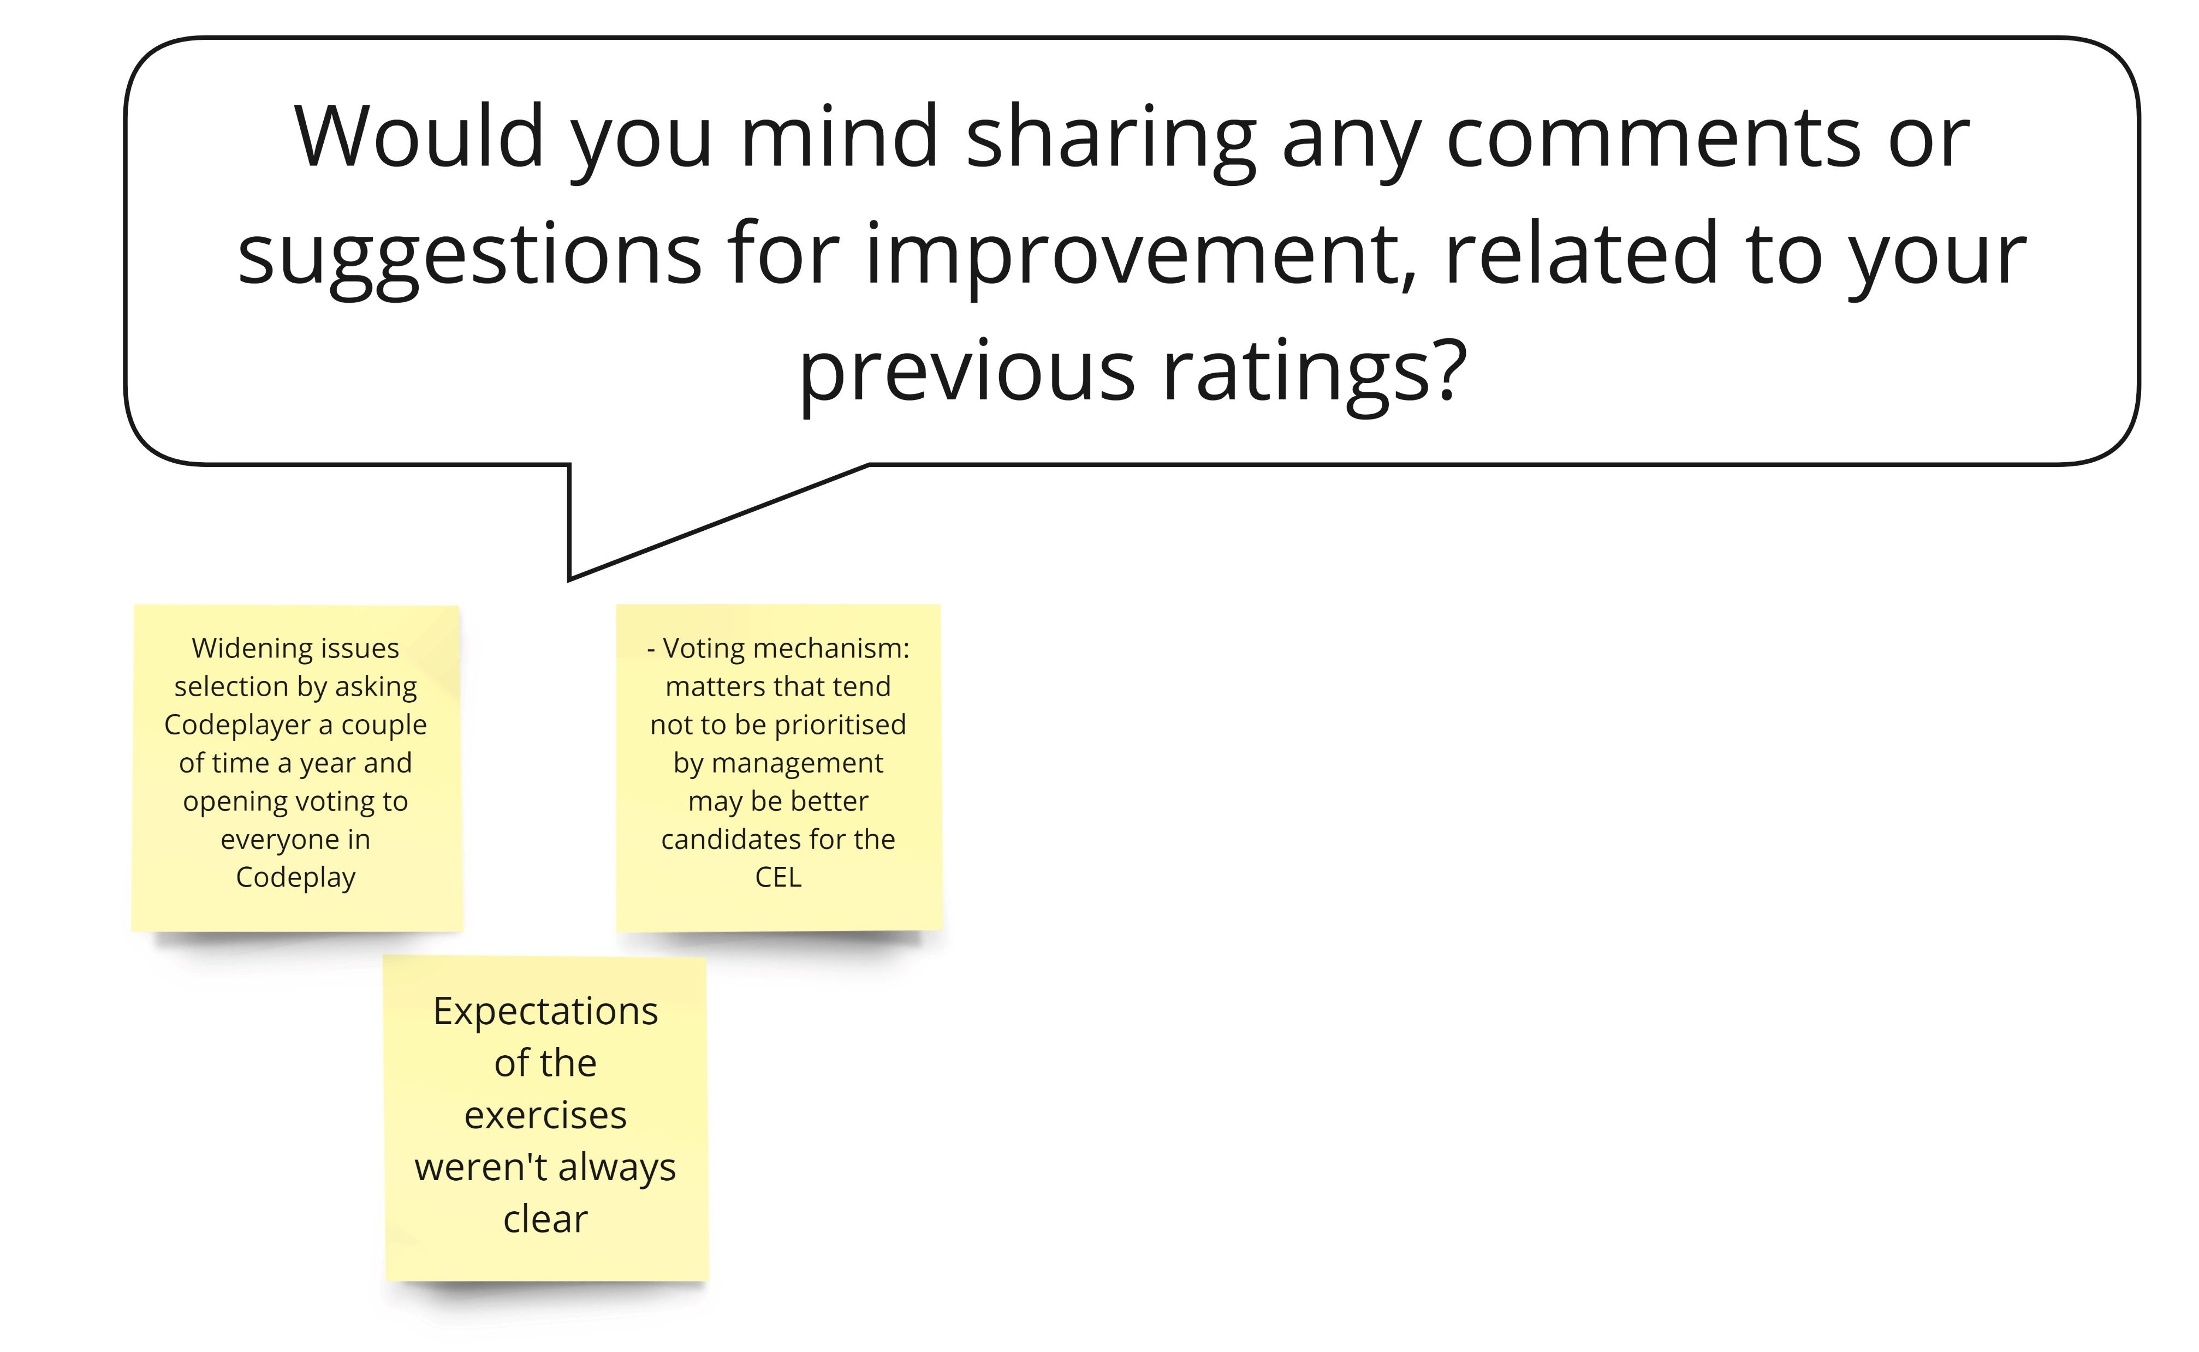
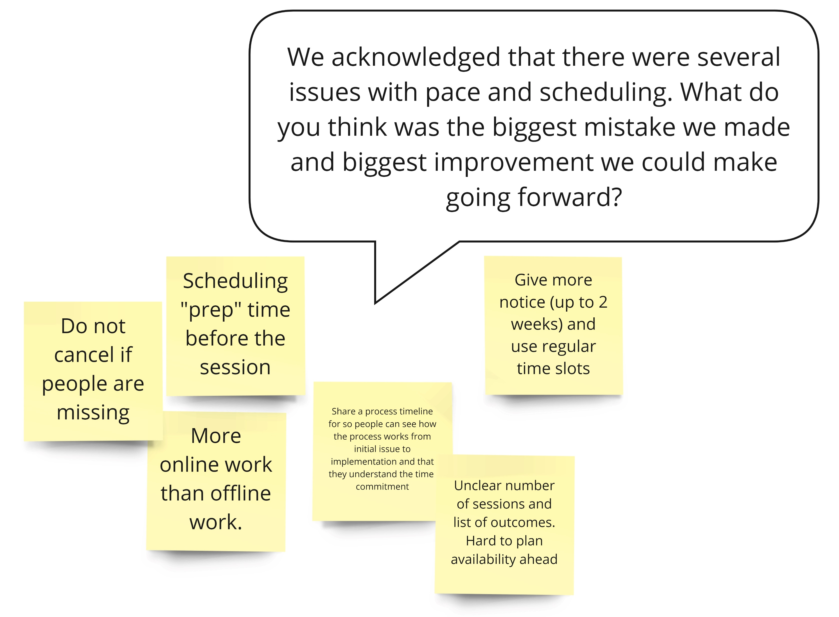
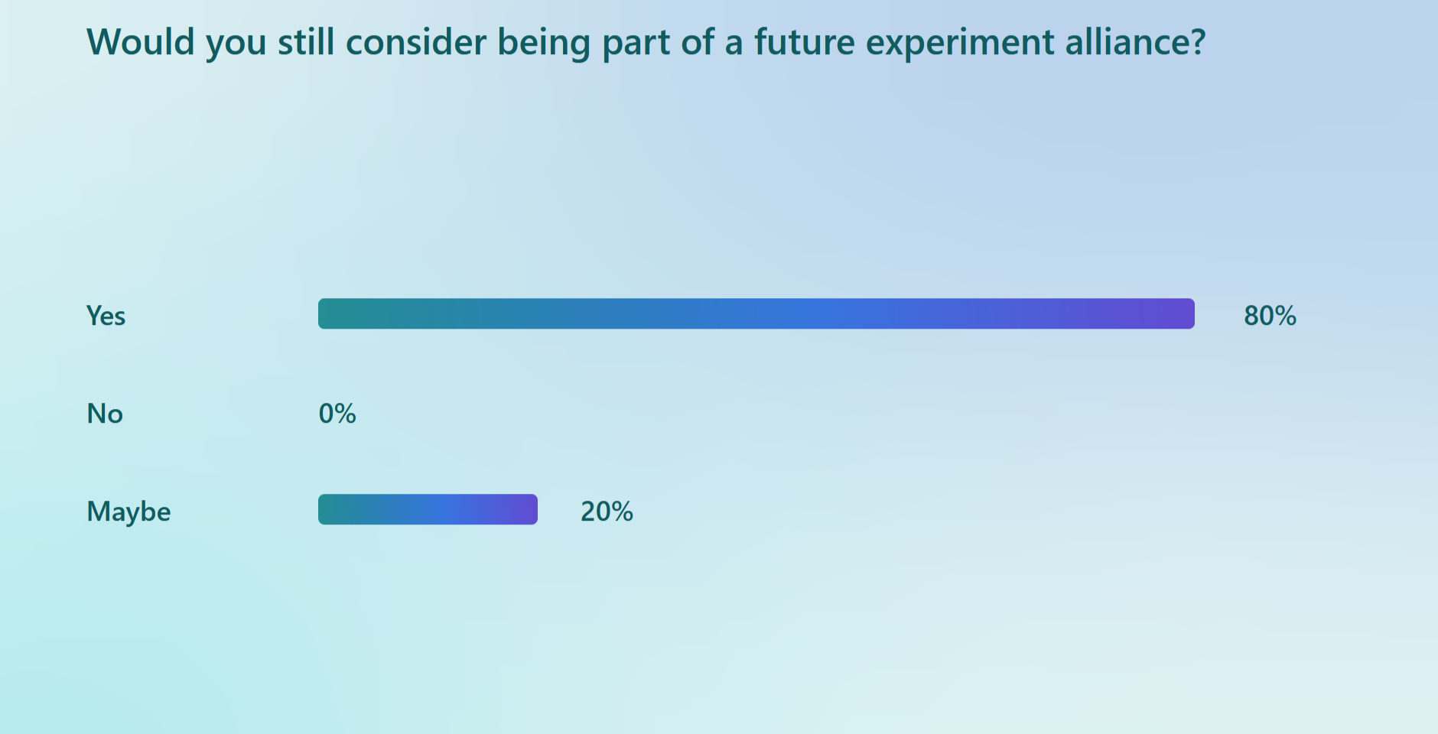

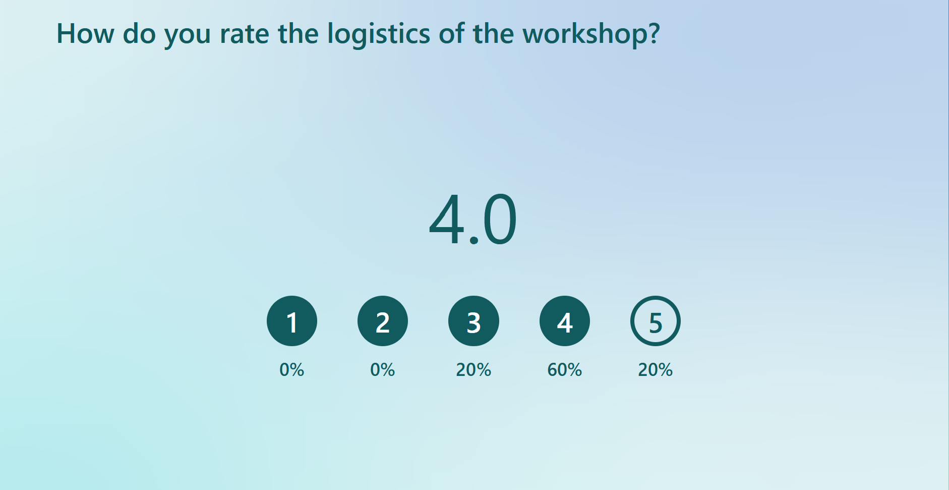
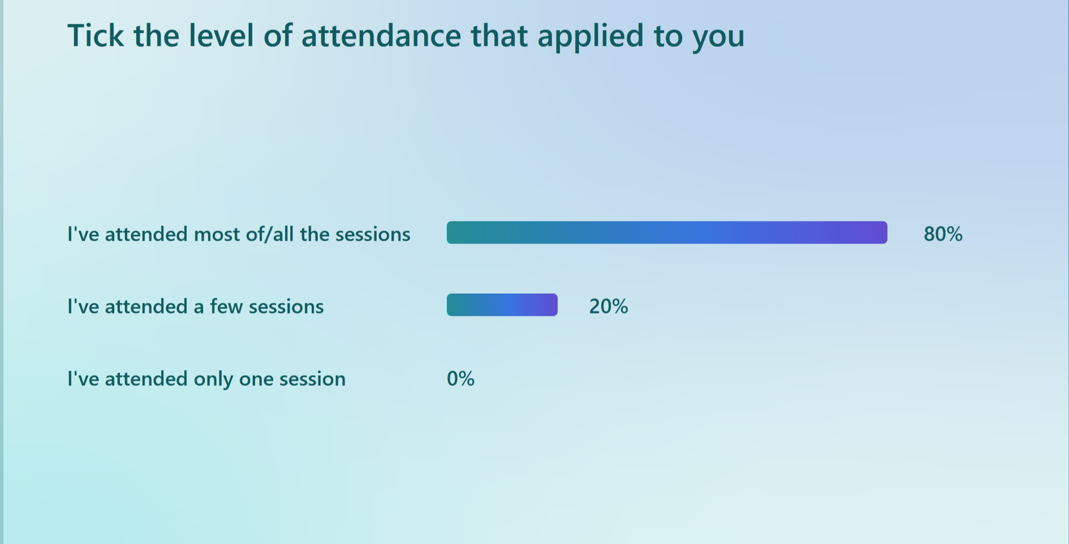

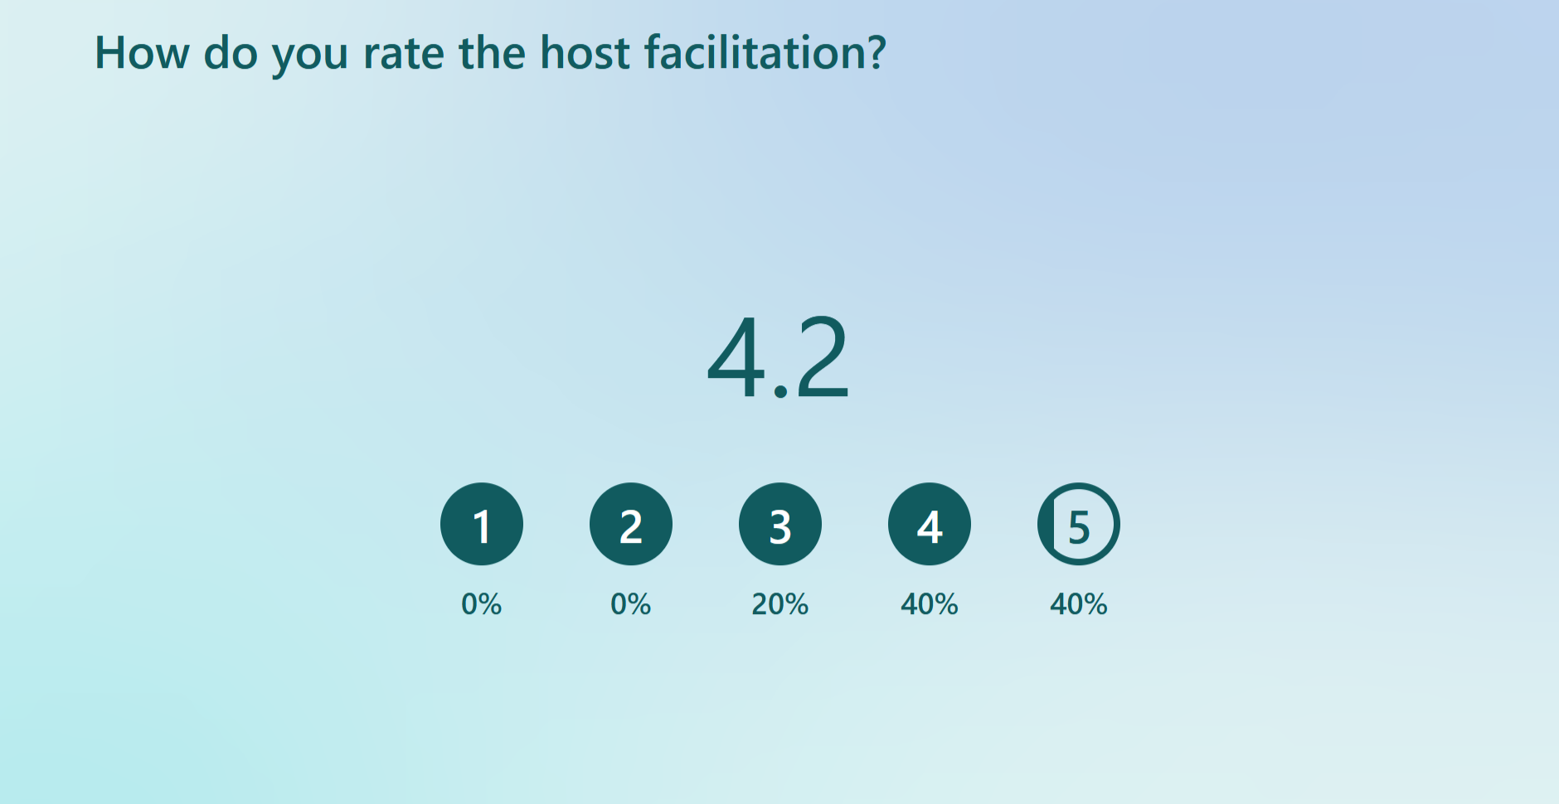
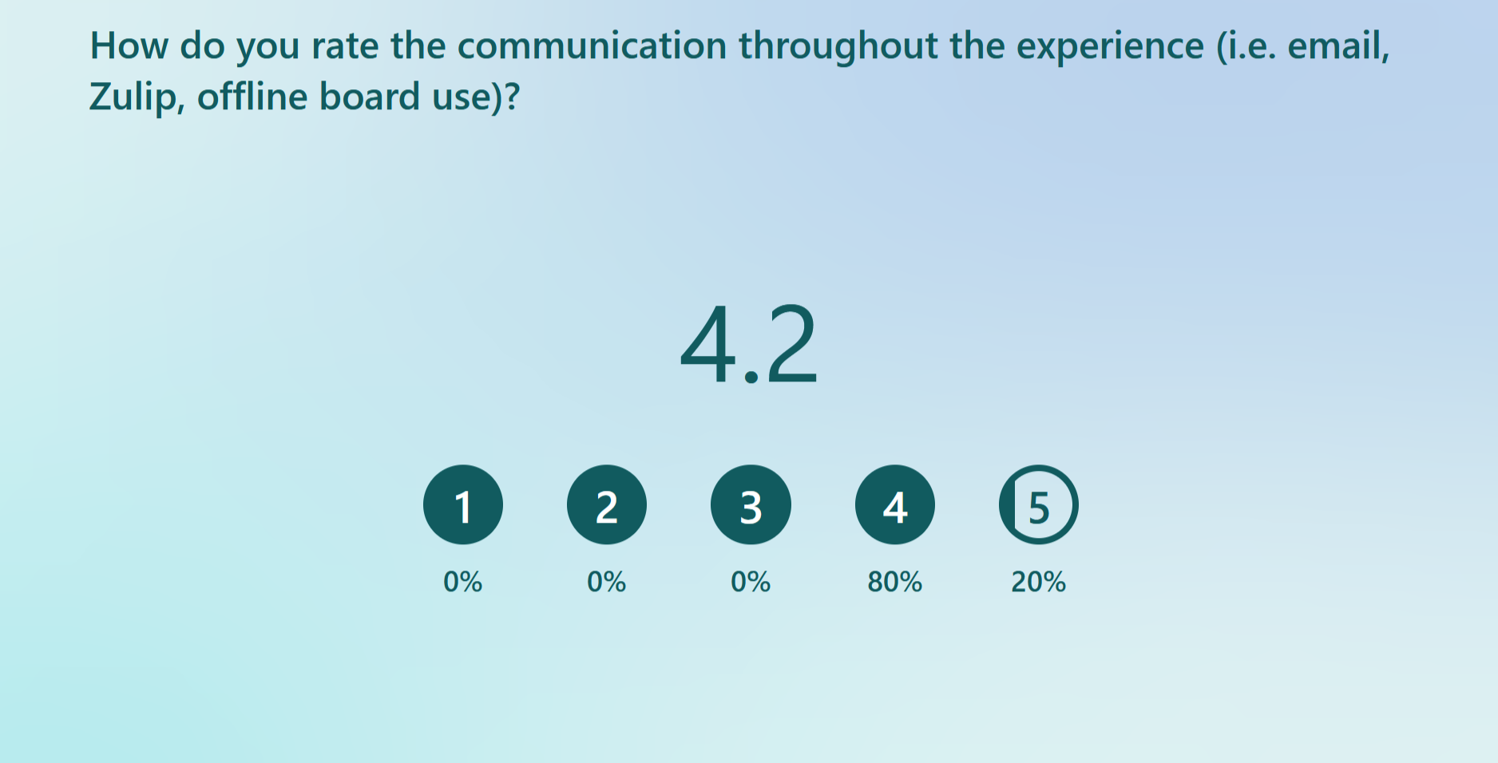
Feedback Survey

Slide 24
Lessons Learned: about the CEL
We asked feedback to the participant via survey and we learned the following:
Improvement suggestions for the workshops:
  Make session schedule available well ahead of time
  Block calendar slot to remind people to do their “homework”
  Do not cancel when people are missing
Find a mechanism to make prioritization activity more transparent, or even open to everyone
Refresh the starting feedback more quickly and accelerate the whole process
Launch multiple Alliances at the same time
Notes:
Fe

Slide 25
Lessons learned: about the experiment
How to improve as a system?
Reason for Change
Leadership
Feedback Taskforce
Culture
Who to include?
Structure and Process

Slide 26



Lessons Learned: about the experiment
Some people asked to apply the experiment, were made aware too late and weren’t bought in
The implementation of the process was too cumbersome and felt like too much overhead for many
People on the receiving end of the experiment found it useful and found it much easier to get up to speed in the teams
Actions:
We will simplify the process and remove some of the artifacts we agreed to capture
We need to improve the communication:
  E.g. run a short training session with every team manager making sure they are aware of the experiment
  Advertise the talk at the next company hall meeting
  Add link to the Confluence process into our Intranet

Slide 27
Where are we now?
The CEL mindset has been well received, but its implementation needs lots of work
The baton of enabler has passed to Operations and the HR department
Beyond the brand of the CEL, the experimentation mindset has spread into other company activities…
…and that’s all we wanted!

Slide 28
Useful Tools & References
“Change.” by Simon Power: https://amzn.eu/d/6GccYP8
My Miroverse template for Sense Making activity: https://miro.com/miroverse/sense-making-activity/?social=copy-link
My Miroverse template for Alliance activities (working agreement & experiment design):
https://miro.com/miroverse/build-an-alliance-for-experiments-design/?social=copy-link
Email me: caruso.ser@gmail.com
LinkedIn: https://www.linkedin.com/in/serenacaruso/
Let me know your story and adaptation of process and templates!

